Slide 1
DCIT 204 Data Structures and Algorithms 1
Sessions 3 - Searching and Sorting
Course Instructor: Prof Kofi Sarpong Adu-Manu
Contact Information: ksadu-manu@ug.edu.gh

Slide 2
Review of algorithms and runtime
Algorithm
An algorithm is a sequence of steps for accomplishing a task.
Runtime
An algorithm's runtime is the time the algorithm takes to execute.

Slide 3
Searching Algorithms
Searching algorithms are methods used to find a specific element or group of elements within a dataset, such as an array or a list.
These algorithms determine the presence or location of the target element(s) in the data structure.
There are two categories: Linear Search and Binary Search

Slide 4
Applications of Searching Algorithms
Data retrieval: Quickly locating data in databases or files.
Information retrieval: Searching for keywords in documents or web pages.
Gaming: Finding objects or characters in virtual spaces.
AI and ML: Efficiently searching through data for pattern recognition.

Slide 5
Linear search
Linear search is a search algorithm that starts from the beginning of a list and checks each element until the search key is found or the end of the list is reached.
Checks each element in the dataset sequentially until the target element is found or the end of the dataset is reached.
Complexity: O(n), where n is the number of elements in the dataset.
Use Case: Useful for small or unsorted datasets.

Slide 6
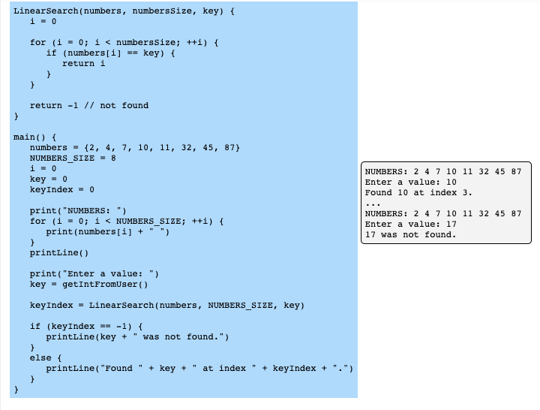
Linear Search (Pseudocode)

Slide 7
Example
Given an unsorted array [8, 3, 7, 1, 4, 6, 2, 5], find the position of the number 4 using linear search.
Steps:
Start at the first element of the array.
Compare the current element to the target value 4.
If the current element is 4, record its position and stop.
If the current element is not 4, move to the next element.
Repeat steps 2-4 until you find 4 or reach the end of the array.
If 4 is found, return its position. If not, return -1.

Slide 8
Solution
Start at index 0: value is 8 (not 4).
Move to index 1: value is 3 (not 4).
Move to index 2: value is 7 (not 4).
Move to index 3: value is 1 (not 4).
Move to index 4: value is 4 (match found).
Return position 4.

Slide 9
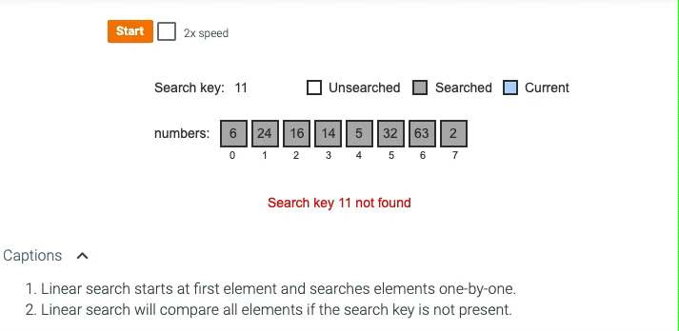
Linear search algorithm checks each element until key is found.

Slide 10
Binary Search
Description: Efficiently searches a sorted dataset by repeatedly dividing the search interval in half.
It compares the target value to the middle element of the dataset and eliminates half of the dataset based on the comparison.
Complexity: O(log n), where n is the number of elements in the dataset.
Use Case: Ideal for large, sorted datasets.

Slide 11
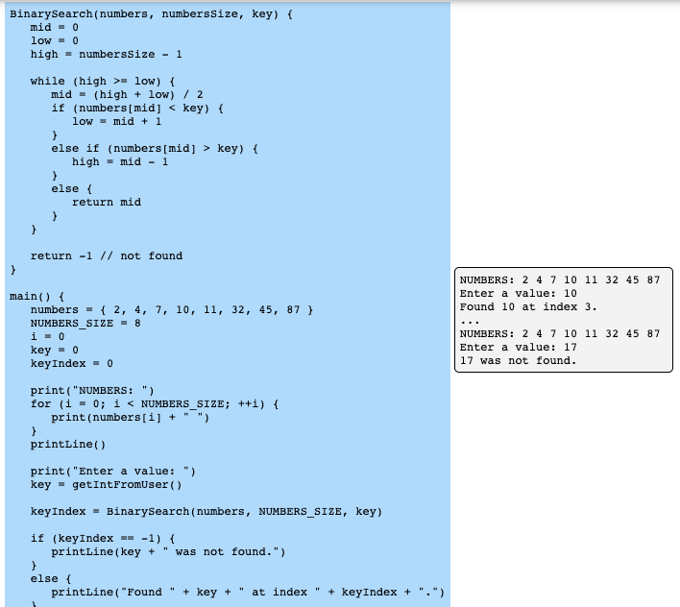
Binary Search (Pseudocode).
Notes:
if (keyIndex == -1) { printLine(key + " was not found.") } else { printLine("Found " + key + " at index " + keyIndex + ".") } }

Slide 12
Example
Given a sorted array [2, 3, 5, 7, 11, 13, 17, 19, 23, 29], find the position of the number 17 using binary search.
Steps:
Initialize two pointers: left at the beginning of the array (index 0) and right at the end (index 9).
Calculate the middle index: mid = (left + right) // 2.
Compare the middle element to the target value 17.
If the middle element is 17, record its position and stop.
If the middle element is less than 17, move the left pointer to mid + 1.
If the middle element is greater than 17, move the right pointer to mid - 1.
Repeat steps 2-6 until you find 17 or the left pointer exceeds the right pointer.
If 17 is found, return its position. If not, return -1.

Slide 13
Solution
Initialize left at 0 and right at 9.
Calculate middle index: mid = (0 + 9) //2 = 4, middle value is 11.
11 is less than 17, move left to mid + 1 = 5.
Calculate middle index: mid = (5 + 9) //2 = 7, middle value is 19.
19 is greater than 17, move right to mid - 1 = 6.
Calculate middle index: mid = (5 + 6) //2 = 5, middle value is 13.
13 is less than 17, move left to mid + 1 = 6.
Calculate middle index: mid = (6 + 6) //2 = 6, middle value is 17.
17 is found, return position 6.

Slide 14
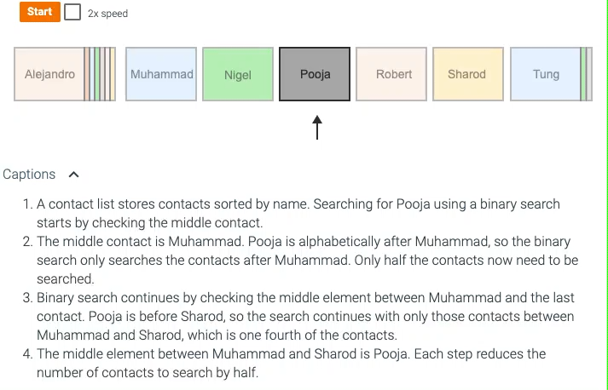
Binary Search
Binary search is a faster algorithm for searching a list if the list's elements are sorted and directly accessible (such as an array).

Slide 15
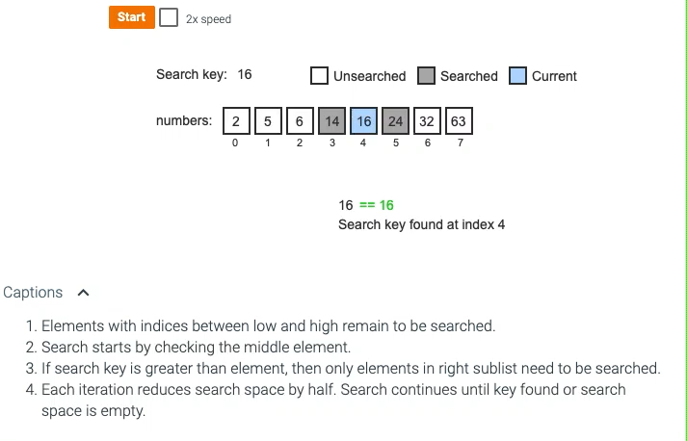
Binary search efficiently searches sorted list by reducing the search space by half each iteration.

Slide 16
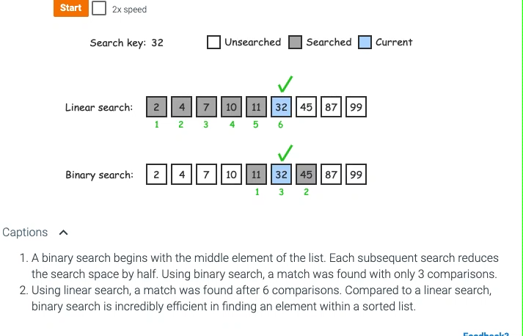
Speed of linear search versus binary search to find a number within a sorted list.

Slide 17
Sorting Algorithms
Sorting algorithms are methods used to arrange elements in a particular order (typically ascending or descending) within a list or an array.
Sorting is a fundamental operation in computer science and is used in various applications, from simple data organization to complex data analysis and processing.
Categories:
Comparison-based Sorting:
Algorithms that determine the order of elements based on comparisons between them.
Non-comparison-based Sorting:
Algorithms that sort elements without comparing them, often based on counting or distributing the elements.

Slide 18
Types
Bubble Sort
Selection Sort
Insertion Sort
Nearly sorted
Shell Sort
Quick Sort
Merge Sort
Radix Sort
Heap Sort
Counting Sort

Slide 19
Applications
Data processing: Organizing and retrieving data efficiently.
Search optimization: Enhancing search algorithms by sorting data first.
Data analysis: Preparing data for statistical analysis.
Computer graphics: Sorting graphical elements for rendering.
Database management: Efficient indexing and querying of database records.

Slide 20
Sorting
For example, given a list of numbers (17, 3, 44, 6, 9), the list after sorting is (3, 6, 9, 17, 44).
You may have carried out sorting when arranging papers in alphabetical order or arranging envelopes to have ascending zip codes (as required for bulk mailings).
The challenge of sorting is that a program can't "see" the entire list to know where to move an element.
Instead, a program is limited to simpler steps, typically observing or swapping just two elements at a time.
So, sorting just by swapping values is an important part of sorting algorithms.
Notes:
Sorting is the process of converting a list of elements into ascending (or descending) order.

Slide 21
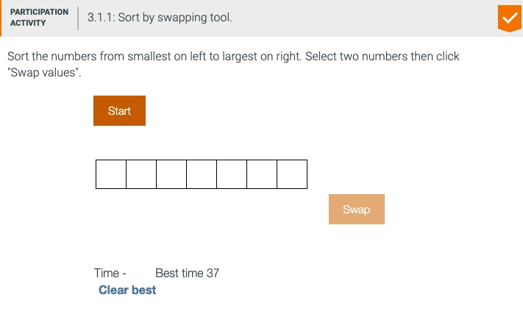
Sort by Swapping

Slide 22
Bubble Sort
Description: Repeatedly steps through the list, compares adjacent elements, and swaps them if they are in the wrong order. This process is repeated until the list is sorted.
Complexity: O(n²) time complexity for average and worst-case scenarios.
Use Case: Simple and easy to implement, but inefficient for large datasets.

Slide 23
Bubble sort pseudocode
BubbleSort(array A)
n = length(A)
for i from 0 to n-1
for j from 0 to n-1-i
if A[j] > A[j+1]
swap A[j] and A[j+1]

Slide 24
Example
Given Array: [5, 1, 4, 2, 8]
Step-by-Step Process:
Initial Array: [5, 1, 4, 2, 8]
First Pass:
Compare 5 and 1: swap them → [1, 5, 4, 2, 8]
Compare 5 and 4: swap them → [1, 4, 5, 2, 8]
Compare 5 and 2: swap them → [1, 4, 2, 5, 8]
Compare 5 and 8: no swap → [1, 4, 2, 5, 8]
Array after first pass: [1, 4, 2, 5, 8]
Continue to sort …..
Notes:
Second Pass:
Compare 1 and 4: no swap → [1, 4, 2, 5, 8]
Compare 4 and 2: swap them → [1, 2, 4, 5, 8]
Compare 4 and 5: no swap → [1, 2, 4, 5, 8]
Compare 5 and 8: no swap → [1, 2, 4, 5, 8]
Array after second pass: [1, 2, 4, 5, 8]
Third Pass:
Compare 1 and 2: no swap → [1, 2, 4, 5, 8]
Compare 2 and 4: no swap → [1, 2, 4, 5, 8]
Compare 4 and 5: no swap → [1, 2, 4, 5, 8]
Array after third pass: [1, 2, 4, 5, 8]
Fourth Pass:
Compare 1 and 2: no swap → [1, 2, 4, 5, 8]
Compare 2 and 4: no swap → [1, 2, 4, 5, 8]
Array after fourth pass: [1, 2, 4, 5, 8]
Fifth Pass:
Compare 1 and 2: no swap → [1, 2, 4, 5, 8]
Array after fifth pass: [1, 2, 4, 5, 8]
Sorted Array: [1, 2, 4, 5, 8]
Explanation
In each pass, the largest unsorted element "bubbles" to its correct position. The algorithm repeatedly steps through the list, compares adjacent elements, and swaps them if they are in the wrong order. The process is repeated until no more swaps are needed, indicating that the array is sorted.

Slide 25
Selection sort
Selection sort is a sorting algorithm that treats the input as two parts, a sorted part and an unsorted part, and repeatedly selects the proper next value to move from the unsorted part to the end of the sorted part.
Complexity: O(n²) time complexity for average and worst-case scenarios.
Use Case: More efficient than bubble sort but still not suitable for large datasets.

Slide 26
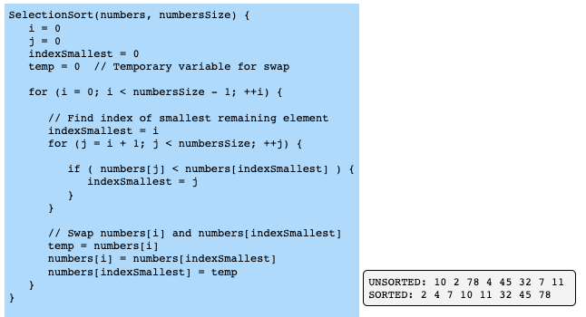
Selection Sort Algorithm (1)

Slide 27
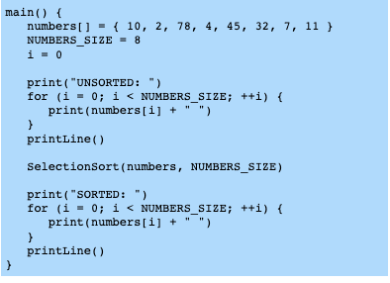
Selection Sort Algorithm (2)

Slide 28
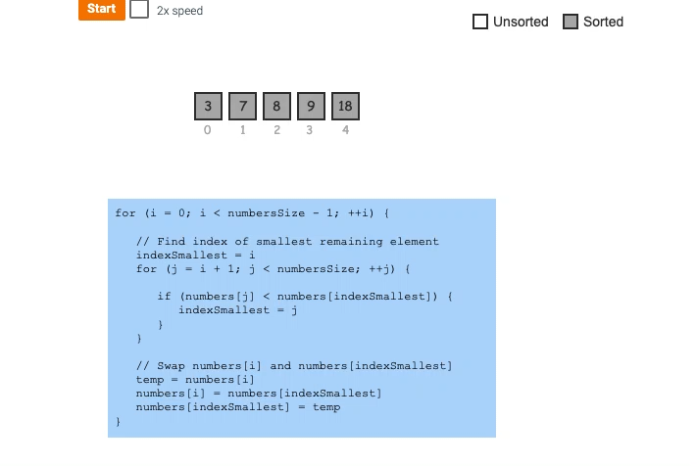
Selection Sort Demo
Notes:
Selection sort treats the input as two parts, a sorted and unsorted part. Variables i and j keep track of the two parts.
The selection sort algorithm searches the unsorted part of the array for the smallest element; indexSmallest stores the index of the smallest element found.
Elements at i and indexSmallest are swapped.
Indices for the sorted and unsorted parts are updated.
The unsorted part is searched again, swapping the smallest element with the element at i.
The process repeats until all elements are sorted.

Slide 29
Insertion sort
Insertion sort is a sorting algorithm that treats the input as two parts, a sorted part and an unsorted part, and repeatedly inserts the next value from the unsorted part into the correct location in the sorted part.
Complexity: O(n²) time complexity for average and worst-case scenarios, but O(n) for nearly sorted data.
Use Case: Efficient for small datasets or nearly sorted data.
Notes:
Builds the sorted array one item at a time by repeatedly picking the next item and inserting it into the correct position in the already sorted part.

Slide 30
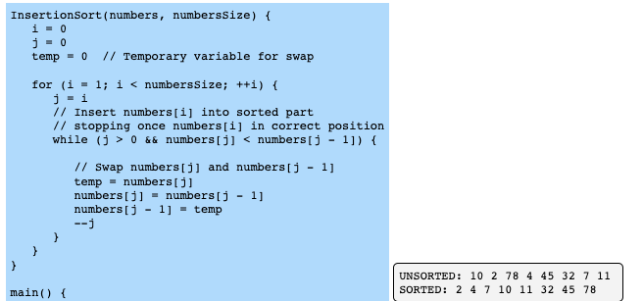
Insertion Sort Algorithm (1)

Slide 31
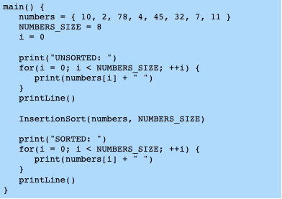
Insertion Sort Algorithm (2)

Slide 32
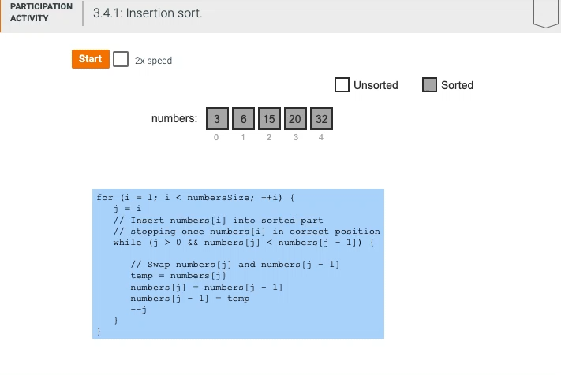
Insertion Sort Demo
Notes:
Variable i is the index of the first unsorted element. Since the element at index 0 is already sorted, i starts at 1.
Variable j keeps track of the index of the current element being inserted into the sorted part. If the current element is less than the element to the left, the values are swapped.
Once the current element is inserted in the correct location in the sorted part, i is incremented to the next element in the unsorted part.
If the current element being inserted is smaller than all elements in the sorted part, that element will be repeatedly swapped with each sorted element until index 0 is reached.
Once all elements in the unsorted part are inserted in the sorted part, the list is sorted.

Slide 33
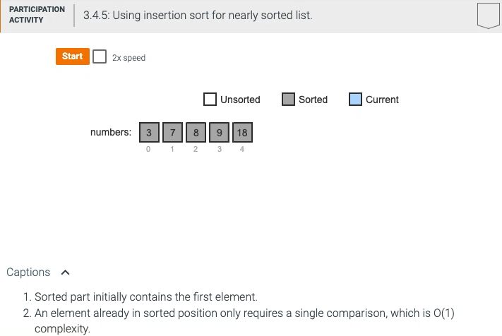
Nearly Sorted
A nearly sorted list only contains a few elements not in sorted order.

Slide 34
Shell sort
Shell sort's interleaved lists
Shell sort is a sorting algorithm that treats the input as a collection of interleaved lists, and sorts each list individually with a variant of the insertion sort algorithm. Shell sort uses gap values to determine the number of interleaved lists.
A gap value is a positive integer representing the distance between elements in an interleaved list. For each interleaved list, if an element is at index i, the next element is at index i + gap value.

Slide 35
Shell Sort’s interleaved lists
Shell sort begins by choosing a gap value K and sorting K interleaved lists in place.
Shell sort finishes by performing a standard insertion sort on the entire array.
Because the interleaved parts have already been sorted, smaller elements will be close to the array's beginning and larger elements towards the end.
Insertion sort can then quickly sort the nearly-sorted array.
Any positive integer gap value can be chosen.
In the case that the array size is not evenly divisible by the gap value, some interleaved lists will have fewer items than others.

Slide 36
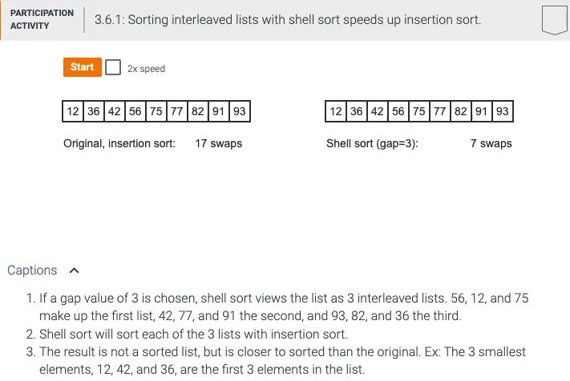
Shell sort demo

Slide 37
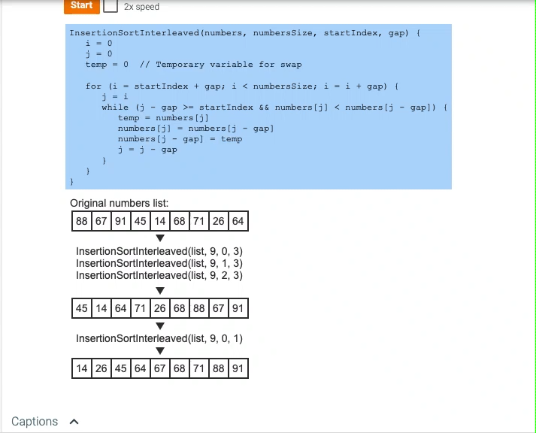
Insertion sort for interleaved lists Demo 2

Slide 38
Quicksort
Quicksort is a sorting algorithm that repeatedly partitions the input into low and high parts (each part unsorted), and then recursively sorts each of those parts.
To partition the input, quicksort chooses a pivot to divide the data into low and high parts.
The pivot can be any value within the array being sorted, commonly the value of the middle array element.
Ex: For the list (4, 34, 10, 25, 1), the middle element is located at index 2 (the middle of indices [0, 4]) and has a value of 10.

Slide 39
Quick Sort
Selects a 'pivot' element, partitions the array into two sub-arrays according to whether they are less than or greater than the pivot, and recursively sorts the sub-arrays.
Complexity: O(n log n) average-case time complexity, but O(n²) in the worst case.
Use Case: Very efficient for large datasets; performance can be improved with good pivot selection strategies.

Slide 40
Quicksort
Once the pivot is chosen, the quicksort algorithm divides the array into two parts, referred to as the low partition and the high partition.
All values in the low partition are less than or equal to the pivot value.
All values in the high partition are greater than or equal to the pivot value.
The values in each partition are not necessarily sorted.
Ex: Partitioning (4, 34, 10, 25, 1) with a pivot value of 10 results in a low partition of (4, 1, 10) and a high partition of (25, 34).
Values equal to the pivot may appear in either or both of the partitions.

Slide 41
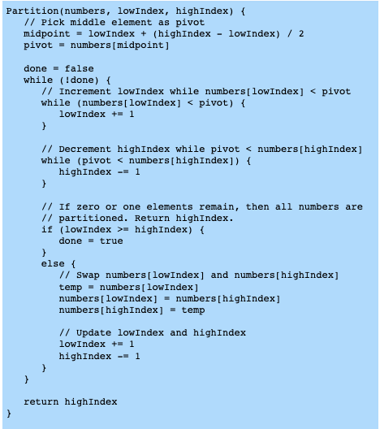
Quicksort algorithm (1).

Slide 42
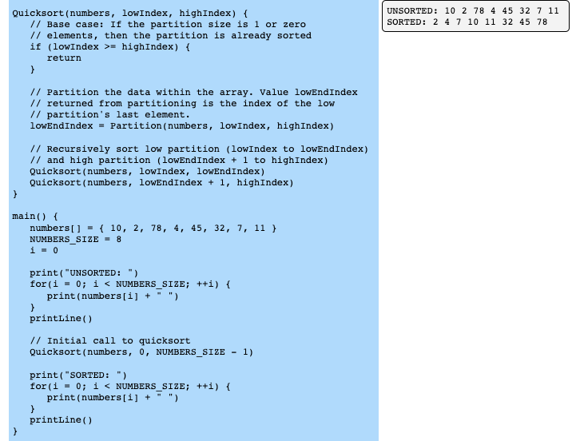
Quicksort Algorithm (2)

Slide 43
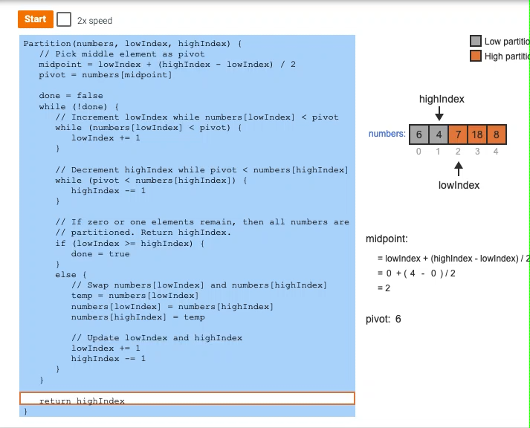
Quicksort demo
Notes:
The pivot value is the value of the middle element.
lowIndex is incremented until a value greater than the pivot is found.
highIndex is decremented until a value less than the pivot is found.
Elements at indices lowIndex and highIndex are swapped, moving those elements to the correct partitions.
The partition process repeats until indices lowIndex and highIndex reach or pass each other, indicating all elements have been partitioned.
Once partitioned, the algorithm returns highIndex, which is the highest index of the low partition. The partitions are not yet sorted.

Slide 44
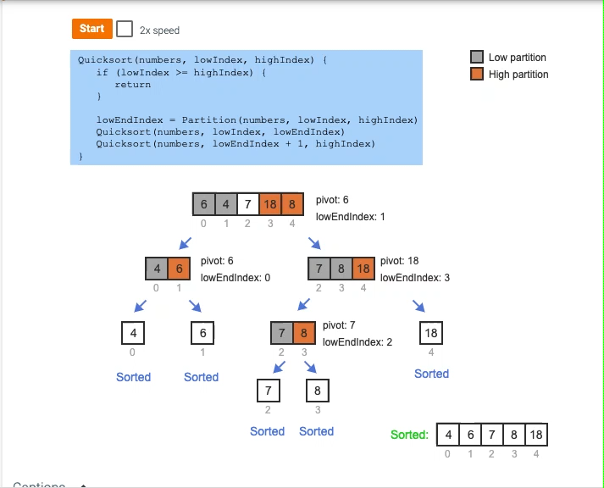
Quicksort Demo

Slide 45
Merge sort
Merge sort is a sorting algorithm that divides a list into two halves, recursively sorts each half, and then merges the sorted halves to produce a sorted list.
Complexity: O(n log n) time complexity for all cases.
Use Case: Efficient and stable, suitable for large datasets
Notes:
Description: Divides the list into halves, recursively sorts each half, and then merges the sorted halves to produce the sorted list.

Slide 46
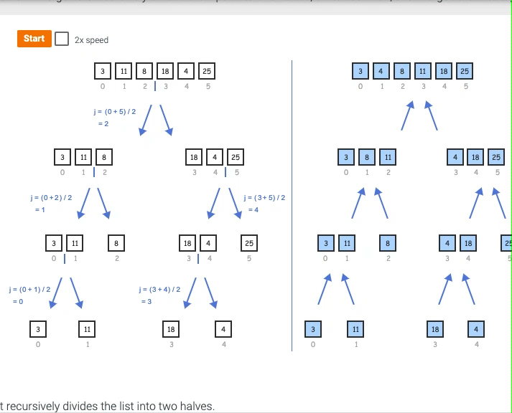
Merge sort
Notes:
MergeSort recursively divides the list into two halves.
The list is divided until a list of 1 element is found.
A list of 1 element is already sorted.
At each level, the sorted lists are merged together while maintaining the sorted order.

Slide 47
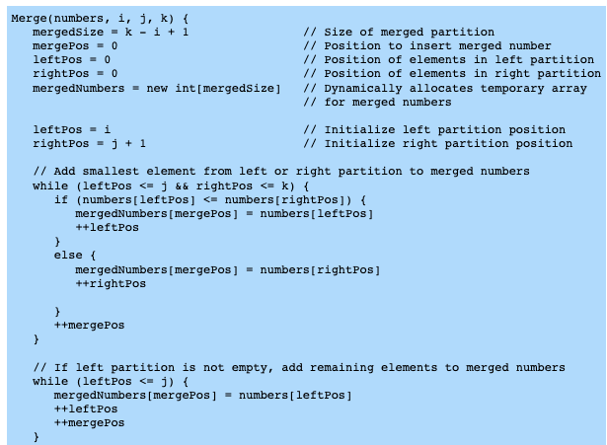
Merge sort algorithm

Slide 48
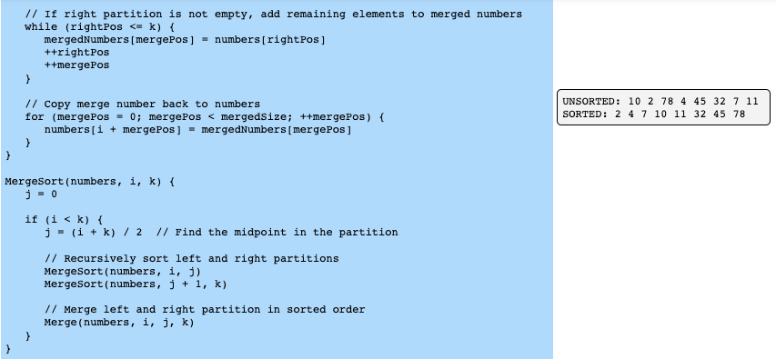
Merge sort algorithm cont..

Slide 49
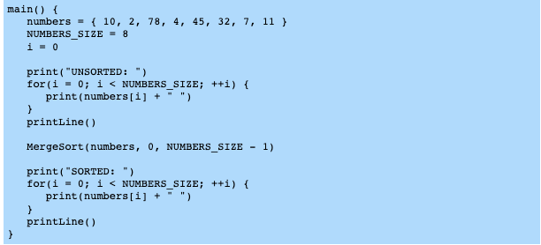
Merge sort algorithm cont..

Slide 50
Radix Sort
Description: Sorts the elements based on individual digits or characters, starting from the least significant digit to the most significant digit.
Complexity: O(nk) time complexity, where n is the number of elements and k is the number of digits in the largest number.Use
Case: Efficient for large datasets with fixed-length integers or strings.

Slide 51
Radix sort
Buckets
Radix sort is a sorting algorithm designed specifically for integers.
The algorithm makes use of a concept called buckets and is a type of bucket sort.
Any array of integer values can be subdivided into buckets by using the integer values' digits.
A bucket is a collection of integer values that all share a particular digit value.
Ex: Values 57, 97, 77, and 17 all have a 7 as the 1's digit, and would all be placed into bucket 7 when subdividing by the 1's digit.

Slide 52
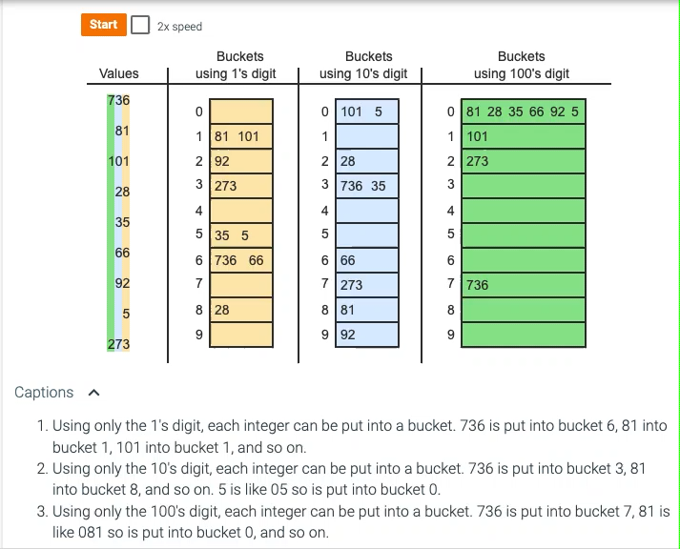
Radix sort demo
A particular single digit in an integer can determine the integer's bucket.

Slide 53
Radix sort algorithm
Radix sort is a sorting algorithm specifically for an array of integers:
The algorithm processes one digit at a time starting with the least significant digit and ending with the most significant.
Two steps are needed for each digit.
First, all array elements are placed into buckets based on the current digit's value.
Then, the array is rebuilt by removing all elements from buckets, in order from lowest bucket to highest.

Slide 54
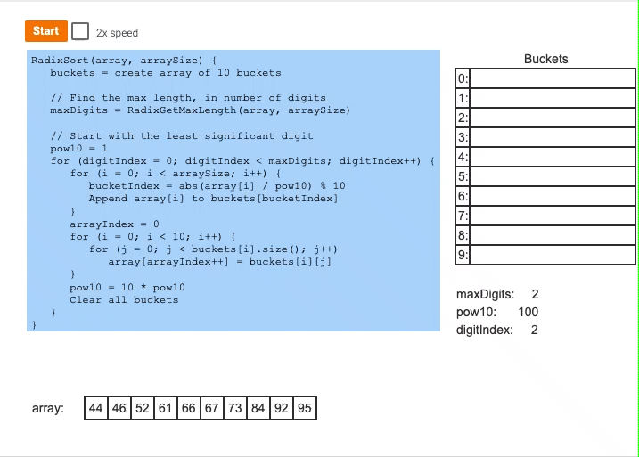
Radix sort algorithm (for non-negative integers)

Slide 55
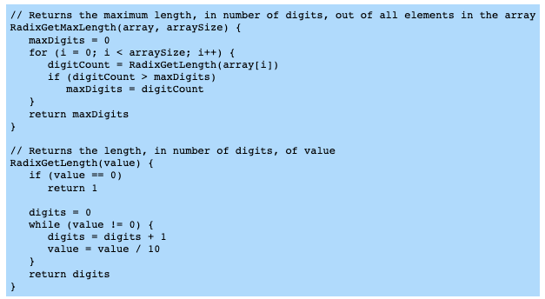
RadixGetMaxLength and RadixGetLength functions

Slide 56
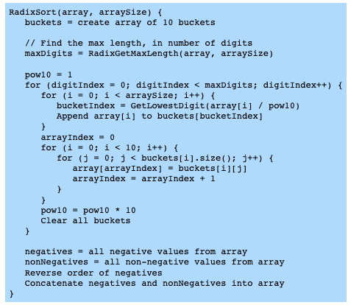
RadixSort algorithm (for negative and non-negative integers)

Slide 57
Overview of fast sorting algorithms
Fast sorting algorithm
A fast sorting algorithm is a sorting algorithm that has an average runtime complexity of O(NlogN) or better.
Sorting algorithm | Average case runtime complexity | Fast?
Selection sort | O(N²) | No
Insertion sort | O(N²) | No
Shell sort | O(N^{1.5}) | No
Quicksort | O(NlogN) | Yes
Merge sort | O(NlogN) | Yes
Heap sort | O(NlogN) | Yes
Radix sort | O(N) | Yes

Slide 58
Element comparison sorting algorithm
A element comparison sorting algorithm is a sorting algorithm that operates on an array of elements that can be compared to each other.
Identifying comparison sorting algorithms
Sorting algorithm | Comparison?
Selection sort | Yes
Insertion sort | Yes
Shell sort | Yes
Quicksort | Yes
Merge sort | Yes
Heap sort | Yes
Radix sort | No

Slide 59
Best and worst case runtime complexity
.
Fast sorting algorithm's best, average, and worst case runtime complexity
Sorting algorithm | Best case runtime complexity | Average case runtime complexity | Worst case runtime complexity
Quicksort | O(NlogN) | O(NlogN) | O(N²)
Merge sort | O(NlogN) | O(NlogN) | O(NlogN)
Heap sort | O(N) | O(NlogN) | O(NlogN)
Radix sort | O(N) | O(N) | O(N)
A fast sorting algorithm's best or worst case runtime complexity may differ from the average runtime complexity.
Ex: The best and average case runtime complexity for quicksort is O(NlogN), but the worst case is O(N²).

Slide 60
Group Activity
Write a Java application that allows users to choose the searching or sorting algorithm type and request the list of items to search or sort.
Compute the running time of the algorithms (theoretical or empirical analysis approach)
Determine the time complexity of your algorithm, searching and sorting algorithms.
Display the search value or the sorted list to the user.
Note: the application should take the list to search or sort at running time, not compile time. [You are submitting the Java code and the computed running time/time complexity of the algorithms]
Date of submission: TBA (Check Sakai)

Slide 61
Reference
Levitin, A. (2012). Introduction to the Design and Analysis of Algorithms ( 3rd Edition). Harlow: Addison Wesley.
Data Structures Essentials: Pseudocode with Java Examples With zyLabs

Slide 62
Acknowledgement
Pearson Education, Inc. Upper Saddle River, NJ.
All Rights Reserved.

